Slide 1
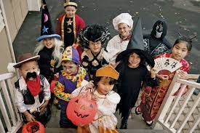
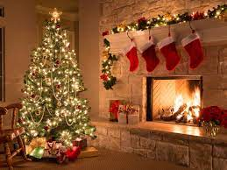
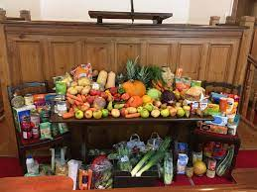
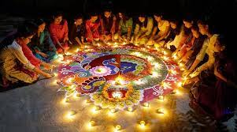
Personal, Social & Emotional
Introduction to the Waves of wellbeing, a PHSCE focused scheme
Continue to model and support positive relationships and behaviours, with reference to our Golden Rules.
Social circles interventions to support children with social interactions
Fortnightly effort assemblies to celebrate achievements
Parents as Partners!
Your chance to join us!
Parent Workshop
Nativity Performance
Weekly Overview
Week 1
Look at and listen to a noisy bonfire story and explore the meaning of Remembrance.
Week 2
Learn about the festival of Diwali and how Hindu’s and some Sikhs celebrate it. Mrs Sandhu to talk about her experiences of celebrating Diwali.
Week 3
Mad Scientist week: Read The Enormous Turnip book, explore forces, plant bulbs and go on an Autumn walk.
Week 4
The Little Red Hen. Explore how flour is made into bread. Explore past and present flour mills
Week 5
Explore the nativity story and why Christians celebrate Christmas.
Week 6
Read the Jolly Christmas Postman. Explore different types of letters & create a letter to Santa.
Week 7
Children to share their favourite Christmas stories and Christmas Creative Week
Maths
Week 1 – exploring 2D shapes (circle and triangle).
Week 2 & 3 – Introduce the number 4 & 5 (recap 1, 2, 3)
Conceptual subitising in different ways.
Week 4 – exploring 2D shapes (square and rectangle).
Week 5 – Introduce ‘addition stories’ (first, now and then).
Week 6 – Composition within 5 (more/less).
Week 7 – Consolidation of maths taught.
Focus books
Rama and Sita
The Enormous Turnip
The Little Red Hen
The Nativity story
The Jolly Christmas postman
Favourite Christmas stories from home
I wonder if we share the same experiences?
Expressive arts & design
Week 1 – Class Poppy Wreath
Week 2 – Clay Diya Lamps
Week 3 – Vegetable printing
Week 4 – Make bread
Week 5 – Create an advent calendar
Week 6 – Christmas cards
Week 7 – Christmas tree decoration
The Resources will then be provided in our Creative area so the children can make/change/adapt and recreate their own in play…
Phonics
Daily phonics lessons.
Oral blending, letter formation, word building, simple CVC words.
Reading books and sound homework.
Opportunities for Enrichment/Visits
Diwali question and answer experience
-Mad scientist day & Autumn Walk
- Post letters to Father Christmas
Vocabulary to cover
Week 1 – bright, sparkling, illuminous, Remembrance
Week 2 – rongoli, diya, Diwali
Week 3 – haul, extract, tug, yank
Week 4 – knead, dough, bakery, past, present
Week 5 – shepherd, Jesus, stable, manger
Week 6 – merry, cheerful, jolly, delightful
Week 7 – traditions, celebrations
Physical Development
Fine motor activities throughout phonics carousel activities
Cosmic Yoga
Physical education lessons taught by ACE’s team
Using the outside play equipment and bikes safely

